Slide 1
Data Analysis of Crime
for the City of Chicago
Presented by:
The Data Analytics Group Inc.

Slide 2
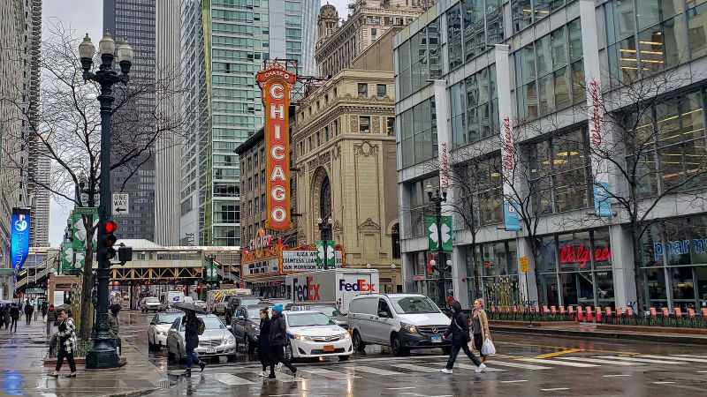
Background

Slide 3


Data Analytics Team Chart
Lina
Basanta
Scott
Nathan
Lina
Ray
James
Jonathan
Amrita

Slide 4
Overview
Purpose:
This analysis identifies Chicago crimes and their relationships to weather conditions. Deep dive is made to understand the types of crimes, crime locations, crimes by gender and by age groups.
Nature of Crime in Chicago
Overview of crime
Overview of weather conditions
When and where?
Locations of Crime overall
Ward 24/28/42
Various Types of Crime
Trend Analysis and Recommendation
Crimes by Weather/Year/Demographic
Findings
Recommendations

Slide 5
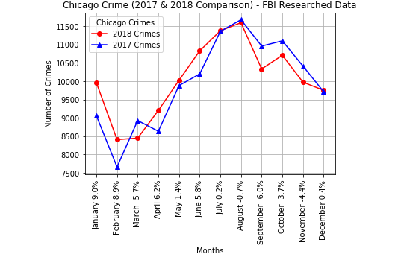
When do the crimes occur?

Slide 6
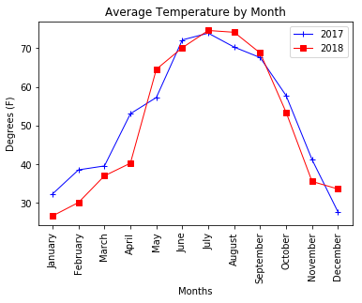
What is the Average Temperature Per Month?

Slide 7
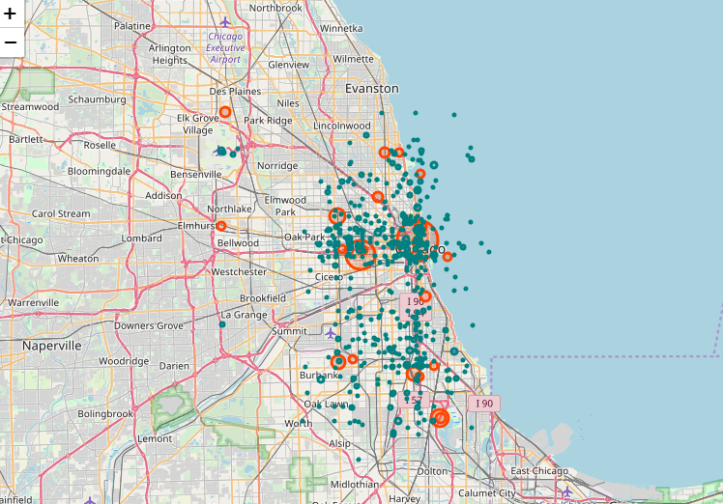
Where Does Crime Happen in Chicago?
https://sites.google.com/view/updatedchicagocrime2017-2018/home 2017-2018 Crime Map

Slide 8
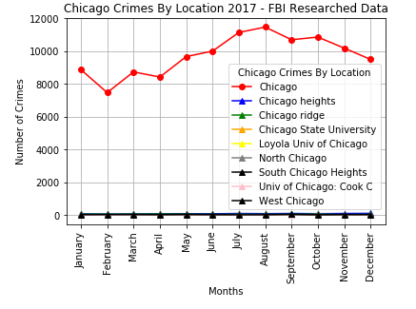
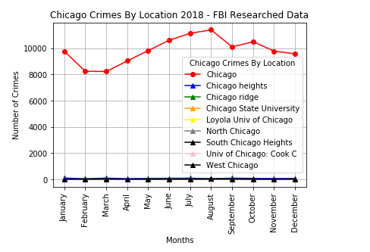
Nature of Crimes: Specific location of occurrences cont.

Slide 9
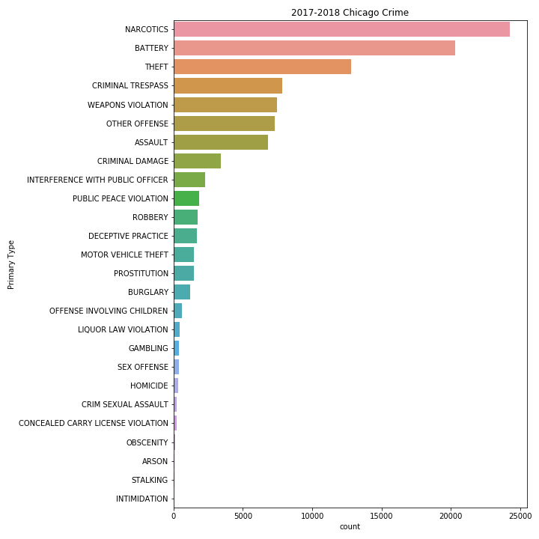
Nature of Crime in Chicago: By Type

Slide 10
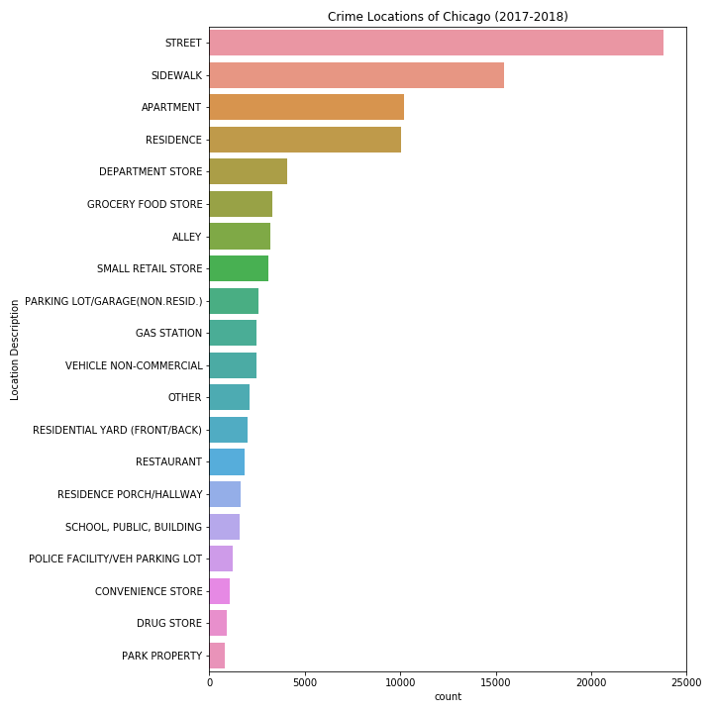
Nature of Crimes: Specific location of occurrences

Slide 11

Breakdown of wards
Explain what wards are

Slide 12
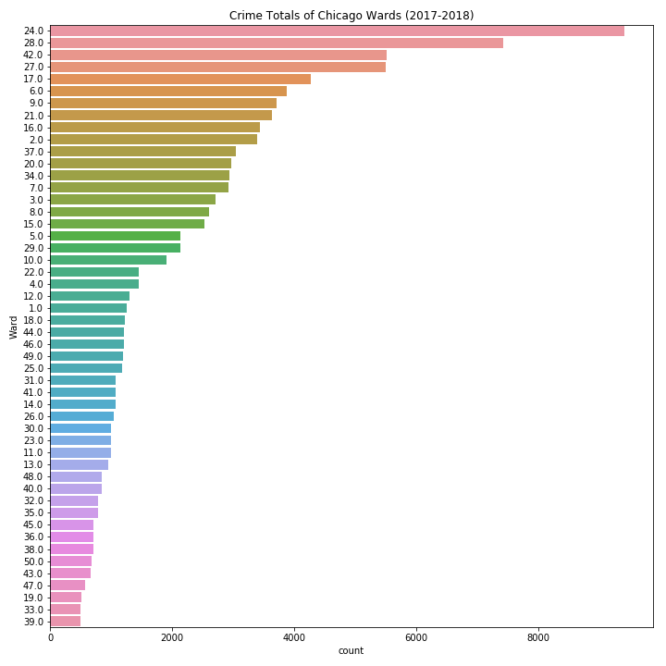
Nature of Crime in Chicago: By Ward

Slide 13
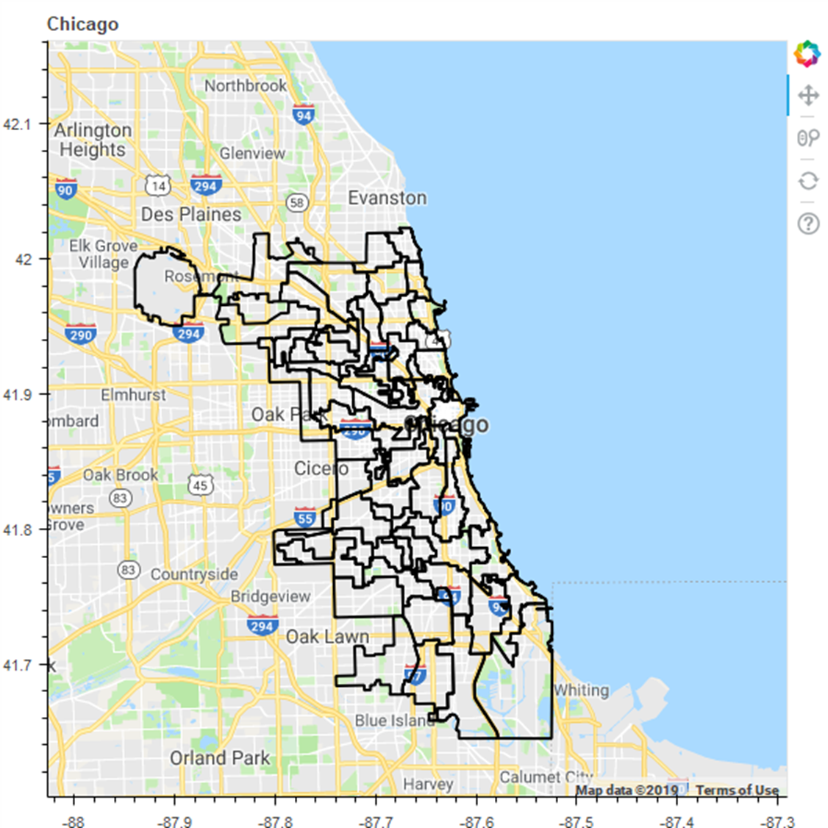
file:///C:/Users/Nathan%20Deering/Documents/DAB/GitLab_Repository/UNCCCLT201905DATA4/01-Lesson-Plans/07-Project-1/gmap.html
42
28
24

Slide 14
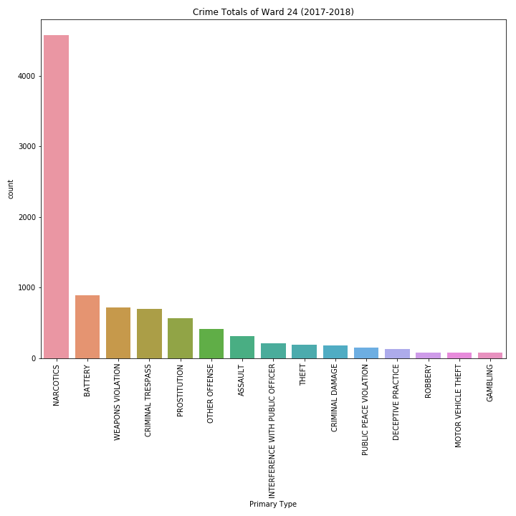
Nature of Crime: Ward 24 Type of Crime
Ward 24: North Lawndale, Douglas Park and Little Village. This ward was also on the top 3 list for homicides
Ward attributes: Violent, poor, struggling
Demographic (2015)
Total Population: 54,909
White: 3.98 percent
Black: 85.72 percent
Hispanic: 9.55 percent
Asian: 0.23 percent

Slide 15
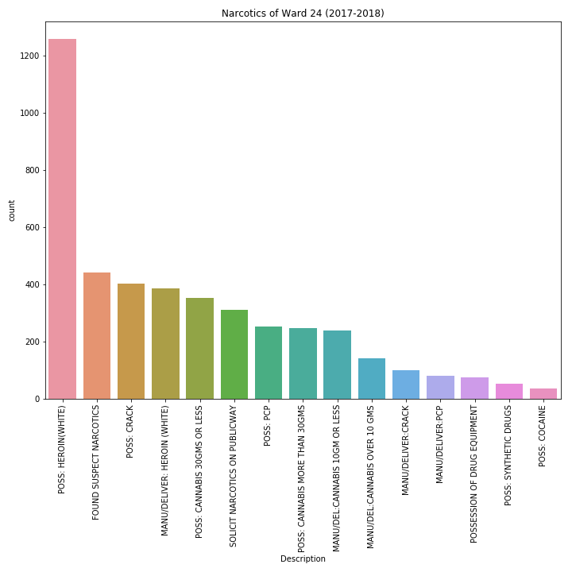
Nature of Crime: Ward 24 Type of Narcotics

Slide 16
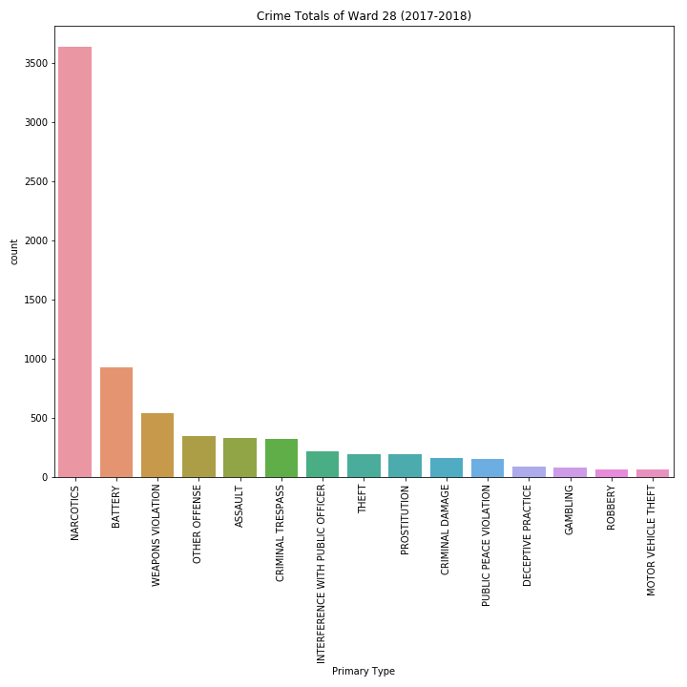
Nature of Crime: Ward 28 Type of Crime
Ward 28: West Garfield Park, East Garfield Park, Austin, Douglas Park, the Illinois Medical District and University Village/Little Italy. This ward was also on the top 3 list for homicides.
Ward attributes: Violent, struggling economically, downtrodden, gentrifying (early stages)
Demographic(2015)
Total Population: 55,199
White: 11.65 percent
Black: 75.65 percent
Hispanic: 6.74 percent
Asian: 5.11

Slide 17
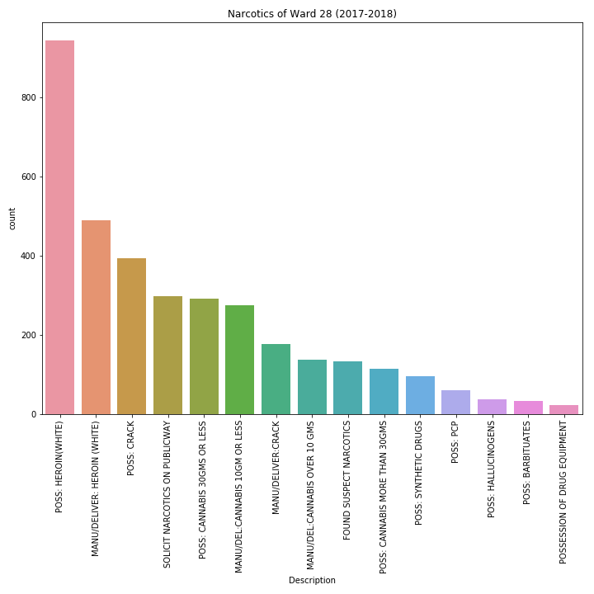
Nature of Crime: Ward 28 Type of Narcotics

Slide 18
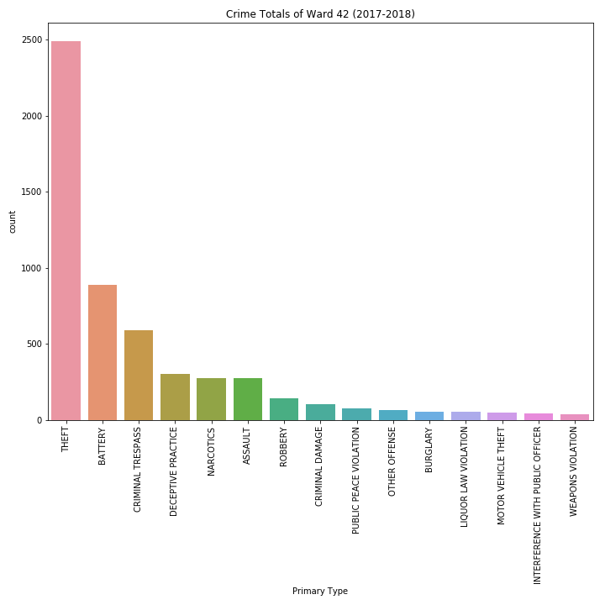
Nature of Crime: Location – Ward 42
Ward 42: The Loop, Streeterville, the Near North Side and Greektown This ward is home to the famous “Bean” statue as well as the River District
Ward attributes: Violent, struggling economically, downtrodden, gentrifying (early stages)
Demographic(2015)
Total Population: 55,199
White: 11.65 percent
Black: 75.65 percent
Hispanic: 6.74 percent
Asian: 5.11

Slide 19
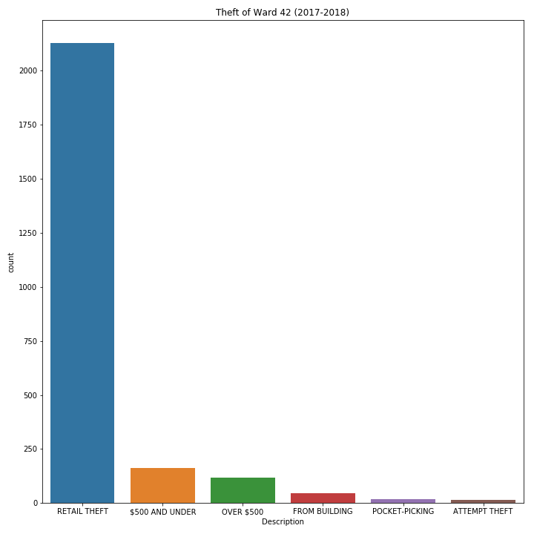
Ward 42

Slide 20
Comparative Analysis of Data
Piece
It
Together
All

Slide 21
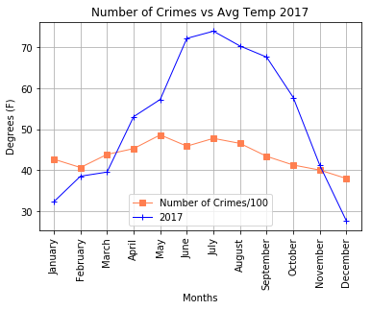
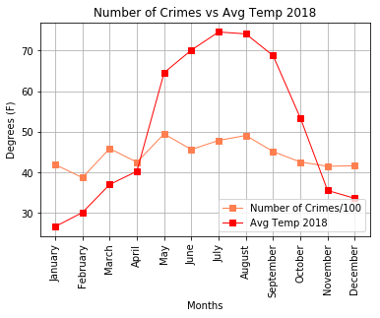
Trend Analysis by Weather (2017-2018) cont.

Slide 22
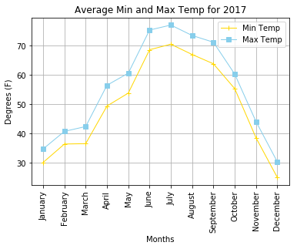
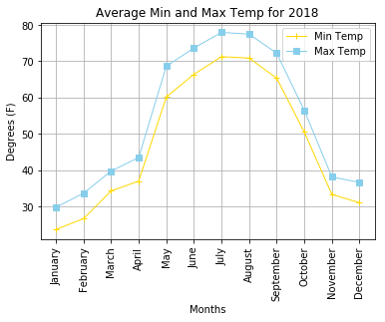
Trend Analysis by Weather

Slide 23
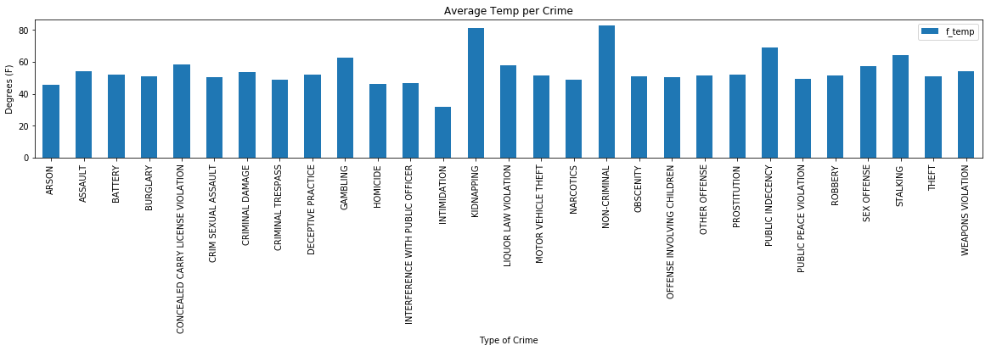
Average Temperature per Crime (2018)

Slide 24
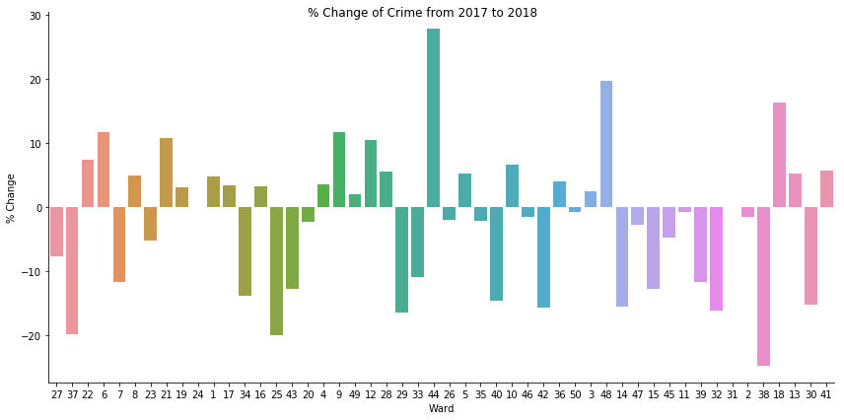
Annual Change in Crime by % (2017-2018)

Slide 25
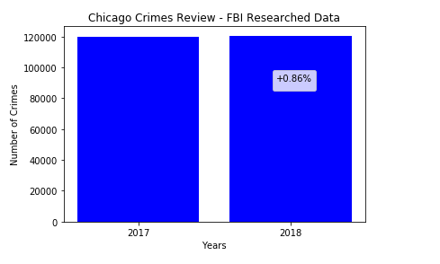
Annual Change in Crime by % (2017-2018) cont.

Slide 26
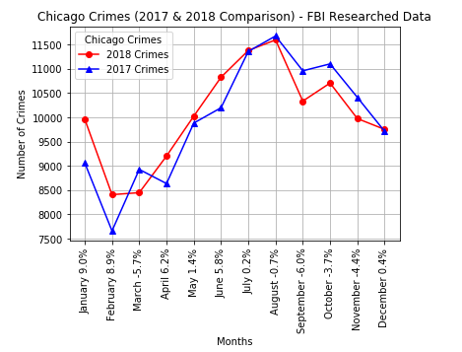
Annual Change in Crime by % (2017-2018) cont.

Slide 27
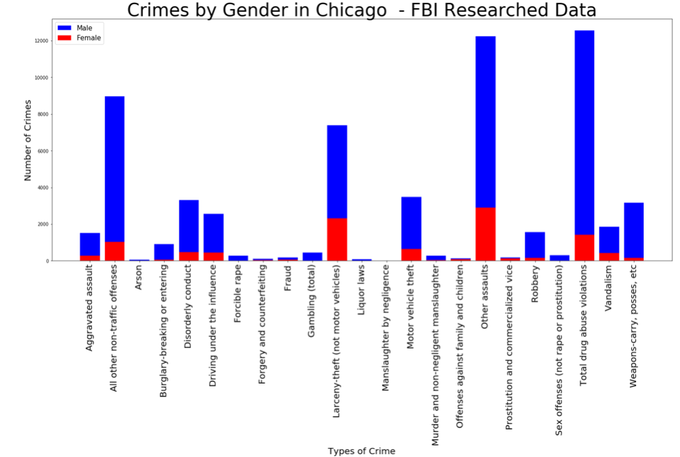
Trend Analysis by Demographic - Gender

Slide 28
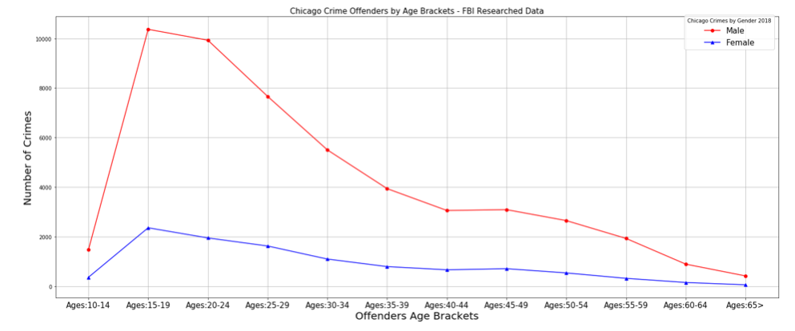
Crime by Age

Slide 29
Data Derived Facts
Our Analysis Reveals:
1
Crimes increased in Chicago from 2017-2018
2
Crimes occurred in specific locales, Heaviest crime: Ward 24, 28, & 42
3
Weather influenced crime, more likely to occur in summer months
4
Theft and Narcotics were the top leading crimes committed
5
Men were more likely to commit a crime than women
6
Crime started from childhood on into adulthood

Slide 30
Recommendation
“Consistently, studies have found that schools play an important role in setting kids on positive developmental trajectories beyond simply their education, particularly through the safe and enriching environments they offer.
In addition to improved educational attainment, school connectedness has also been associated with lower rates of substance abuse, violence, suicide attempts, and pregnancy.
Further, racial and ethnic minorities, as well as students with disabilities, bear a disproportionate burden of suspension and expulsion.
A 2014 report from the U.S. Department of Education found that such disparities begin as early as preschool. Further, a 2014 study in the American Educational Research Journal concluded that, even after taking into account a student’s infraction type, gender, socioeconomic status and school demographics as well as the school principal’s attitude towards discipline…” Crime Prevention Projects
Recommendations: (SNAP)
Revisit our zero tolerance policies
Keep suspensions to the minimal
Initiate after school programs
Improve personal & social skills (kids engaging each other)
Potential juvenile curfew
Initiate programs that decrease aggression and other problematic behaviors
Initiate programs that improved self-confidence
Initiate residential conflict programs
Increase mental help programs
Develop parenting and siblings’ counseling groups.

Slide 31
Recommendations
Possible Outcomes
Pros (Benefits)
Cons (Drawbacks)
• Less school violence and bullying - More friends • Fewer interactions with school principals • Improves parent-child relationships and emotional states • Reduced stress and anxiety • Reduced rates of depression • Increased overall happiness • Improved self-confidence
• Angry outbursts - Physically aggressive behavior • Verbally aggressive or defiant behavior • Lacks self-control and problem-solving skills • Has difficulty making and maintaining healthy relationships • Stealing • Bullies others

Slide 32
?
?
Got any questions?
?
?
?

Slide 33
Blank

Slide 34
Old links
Interactive Link 1
Interactive Link 2
https://sites.google.com/view/project1-chicagocrime/crime-map
https://sites.google.com/view/crimemapby-type/home

Slide 35
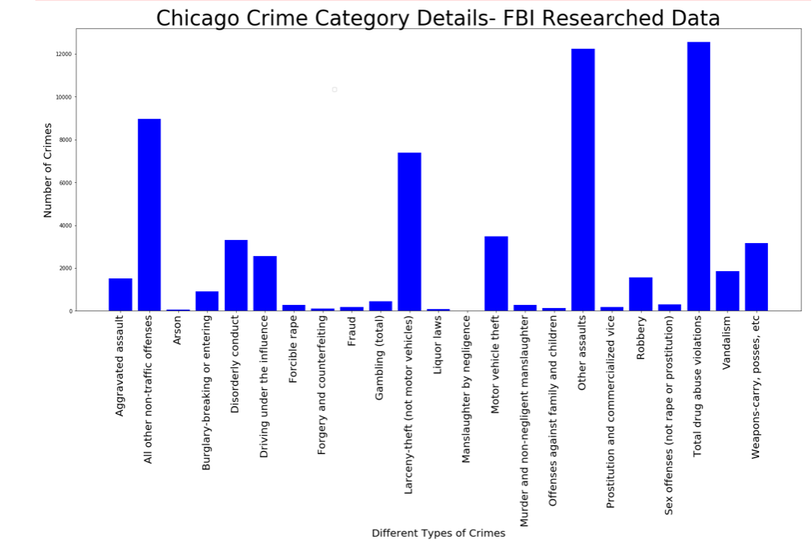
Nature of Crime in Chicago: By Type cont.

Slide 36
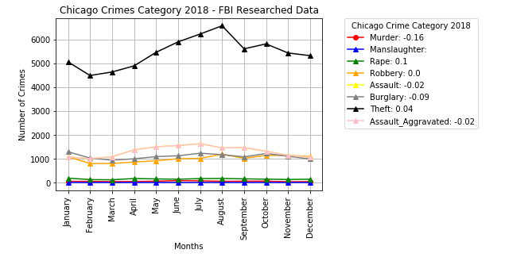
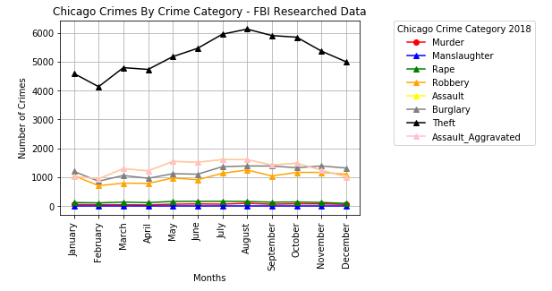
Nature of Crime in Chicago: By Type cont.

Slide 37
A couple of side notes….
This data only represents cases where arrests were made
Any cases that had empty or N/A values were removed from he dataset

Slide 38
Sources (added by ND)
https://www.nbcchicago.com/blogs/ward-room/Get-to-Know-Your-Ward-24th-Ward.html
https://www.nbcchicago.com/blogs/ward-room/Get-to-Know-Your-Ward-28th-Ward-290971061.html
https://www.nbcchicago.com/blogs/ward-room/Get-to-Know-Your-Ward-28th-Ward-290971061.html

